Slide 1
DAY15 PPT
MODULAR FUNCTIONS,OBJECT CODE

Slide 2
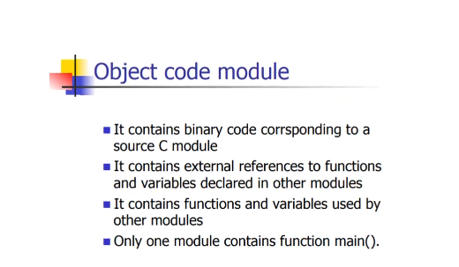
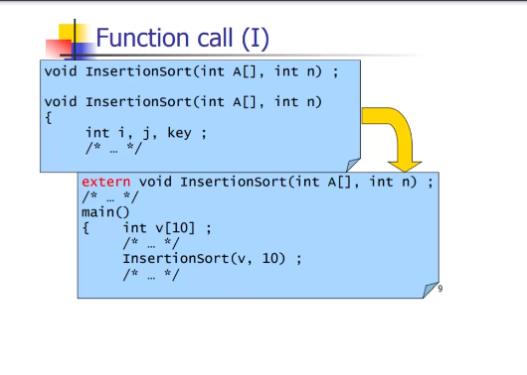
Object code

Slide 3
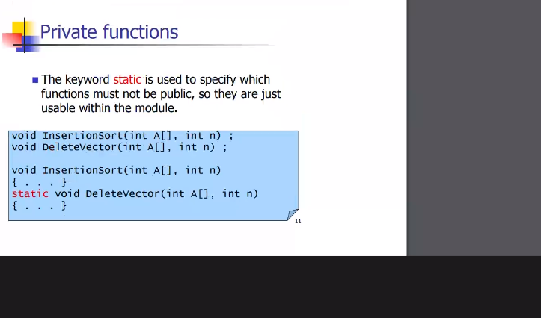
Private functions

Slide 4
MODULAR FUNCTIONS
A modular function, in the context of programming, is a function that encapsulates a specific task or functionality within a program and can be reused across different parts of the program or even in different programs. Here's a breakdown of what modular functions are and their benefits:
What is a Modular Function?
Encapsulation: A modular function encapsulates a specific piece of functionality or a task within a program. It hides the implementation details from the rest of the program, allowing for a clear separation of concerns.
Reusability: Modular functions can be reused multiple times within the same program or across different programs. Once defined, a modular function can be called whenever the specific functionality it provides is required.
Abstraction: Modular functions abstract away the details of how a particular task is accomplished. Other parts of the program only need to know what the function does, not how it does it. This promotes code readability and maintainability.
Modifiability: Because modular functions isolate specific tasks, they make it easier to modify or update the functionality without affecting other parts of the program. This makes maintenance and updates more manageable.
Testing: Modular functions can be tested individually, allowing for easier debugging and troubleshooting. Since each function performs a specific task, it's easier to pinpoint errors and verify the correctness of the code.

Slide 5
BENEFITS OF MODULAR FUNCTION
Code Organization: Modular functions help organize code into smaller, manageable units, making it easier to understand and maintain.
Code Reusability: By encapsulating functionality into modular functions, you can reuse code across different parts of the program or even in different projects, reducing redundancy and promoting efficiency.
Ease of Collaboration: Modular functions facilitate collaboration among developers by providing well-defined interfaces for interacting with different parts of the program. This allows multiple developers to work on different modules simultaneously without interfering with each other's code.
Scalability: Modular functions make it easier to scale and extend a program. New functionality can be added by creating new modular functions or by extending existing ones, without affecting the rest of the codebase.
Readability and Maintainability: By breaking down a program into modular functions, the code becomes more readable, understandable, and easier to maintain. Each function focuses on a specific task, making it easier to comprehend its purpose and behavior.
Overall, modular functions are a fundamental concept in software engineering, contributing to the development of robust, maintainable, and scalable software systems.

Slide 6
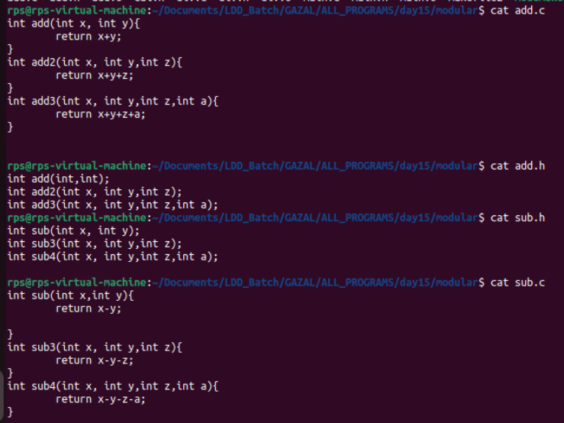
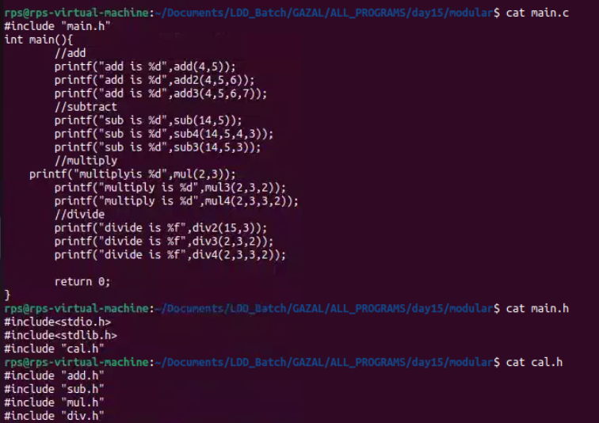
MODULAR FUNCTION EXAMPLE

